Slide 1





Predicting PhageHost Interaction
With Language Models

Slide 2


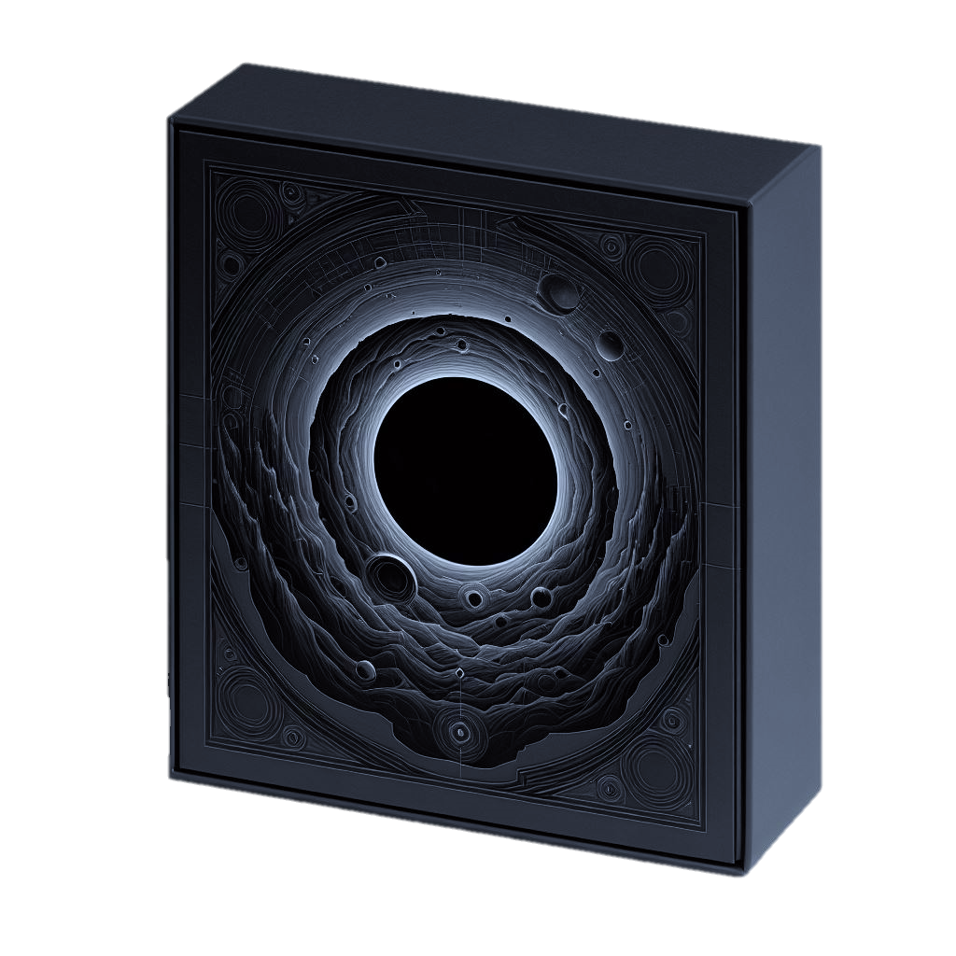
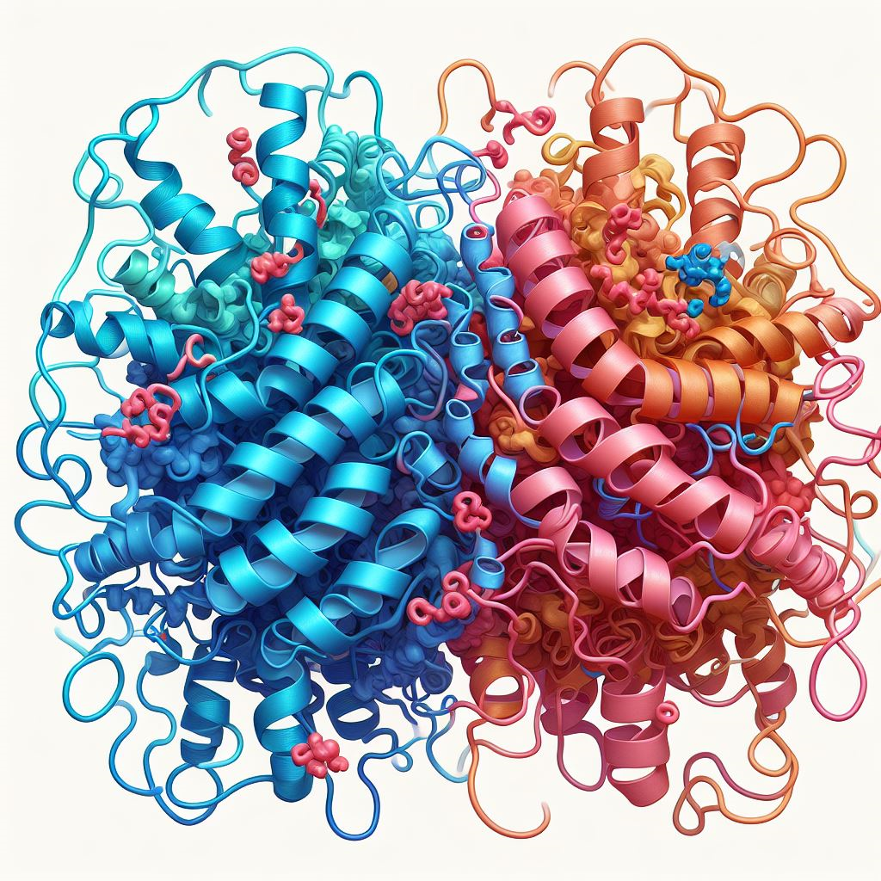


Overview
FLTDACRVYQNGIWMHKSPX
45813960782190365721
Notes:
What is it about?
Use viruses (bacteriophages) to fight bacterial infections
Focus on protein-protein interaction – binary classification
How? Only sequences -> language models to extract features -> Random forest to classify

Slide 3
The aim
A tool to predict viral adhesion
Notes:
Provide a new tool to deepen the understanding ofhow virus infect the bacteria, as way of defeating infections

Slide 4
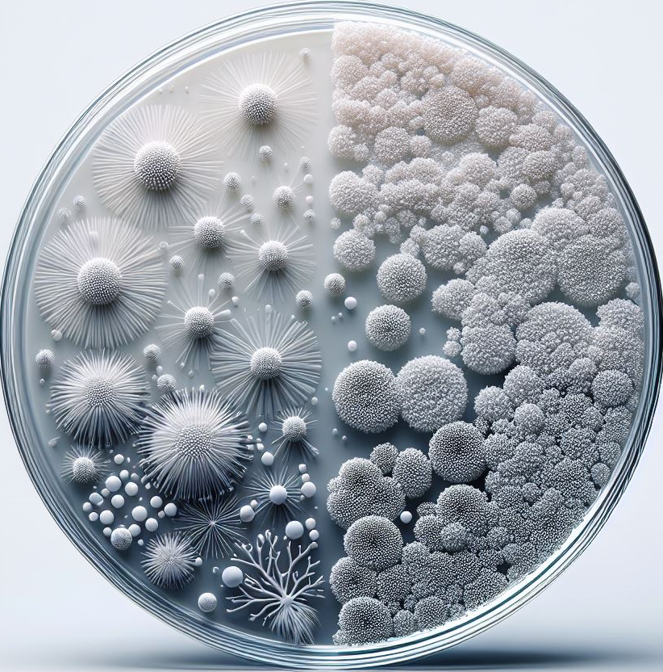
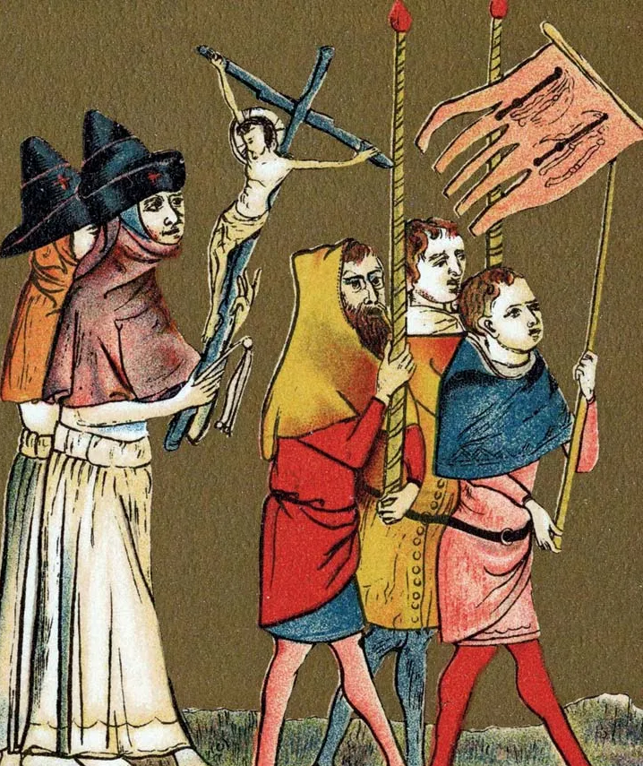
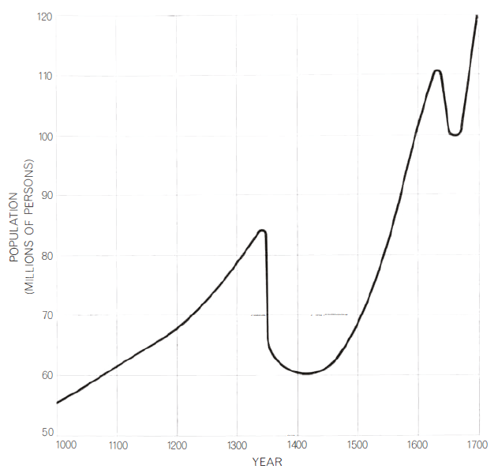
The need
1UP
Notes:
Many bacterial pandemics: plague of Justinian 541 AD – Black death 1348-1350 (worst disaster ever fallen on humankind) – Bubonic Plague 1665 England – Cholera 1830-1837 Europe
They thought of God’s punishment

Slide 5
The Usage
High Specificity
Tackle Multiple Resitance
Mind Safety
Advantages
Phage therapy
Notes:
High specificity (different in patients) -> broad spectrum or cocktail
Tackle multiple resistance -> cocktail or sequential (patient’s immune system, extend potential treatment regimen)
Careful -> not toxic products, don’t use generalized transducing phages
Advantages -> combination with antibiotics reduce minimum inhibitory concentration, biofilm, vectors for nucleases (target resistance or virulence genes, production upscale easy and inexpensive

Slide 6
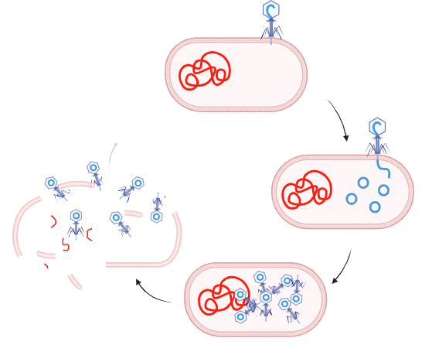
Infection mechanism
Bacterial Receptors
RBPs
Plaque Essays
Notes:
adsorption, phage genome insertion and replication, viral particle production, and host cell lysis
Adhesion: Interaction between phage proteins and bacterial surface receptors -> various kinds: proteins, suars, cell surface structures (LPS, O-antigen). We care of proteins
RBPs located at tails, fundamental for specificity: tail spikes, tail fibers and spike proteins, depending on the phage type
Traditional plaque essays: rather than focus on adhesion, rely on use of complete phages and cell death visualization –> describe effectiveness of the whole process, rather than initial interaction

Slide 7
PPIs
Competing ligands
Protein interface
Hot spot residues
Notes:
The interactions happen in the complex cellular environment. Various protein can compete for the same ligand. The complex formation is a chemical equation, with the affinity as the complex concentration at equlibrium. A low affinity ligand, if high concentration, might win.
Core importance in the interaction si the protein interface. Both amino acid chemistry must be suitable, and shape complementary. Also, a post-translational modification may switch from binding to non-binding state
Some residues, named hot spot residues, seem to be organized in the unbound state, suggesting the presence of generic binding areas

Slide 8
Materials and methods

Slide 9


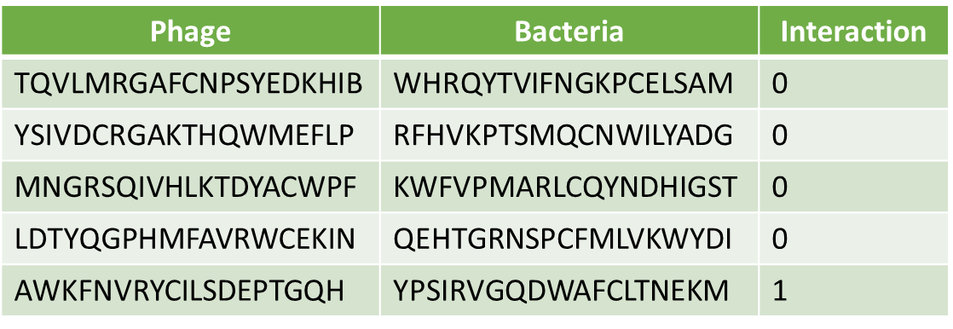
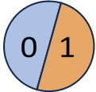


Model overview

Slide 10
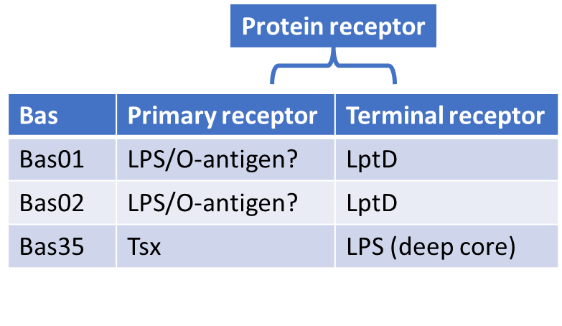
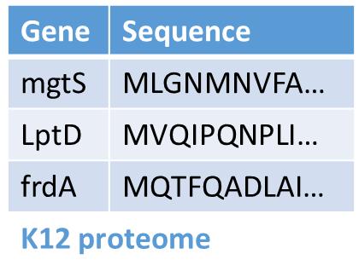
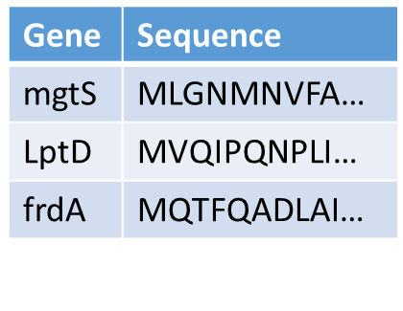
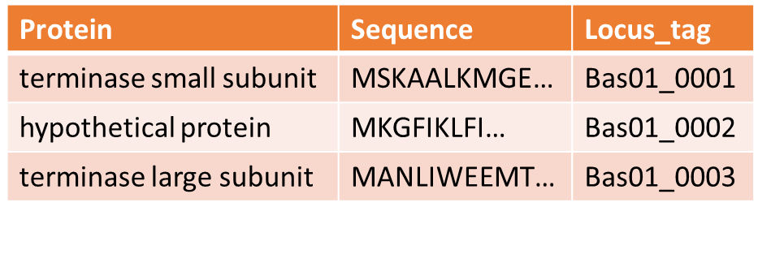
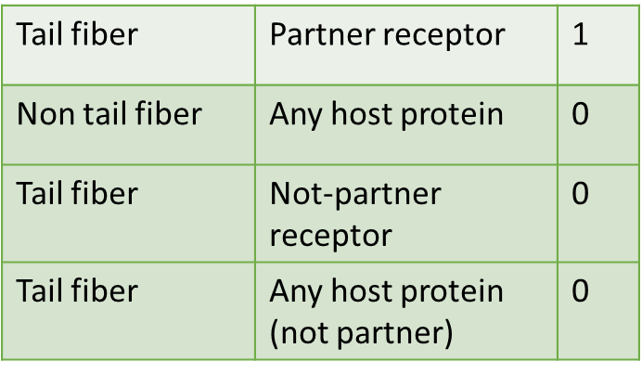
Datasets
E. coli K12 MG1655 ΔRM
Tail fibers
Others
Labeling rules
Notes:
Used data from Maffei et al, explore phages infecting E.coli K12. BASEL collection has 68 phages of the study plus 10 known models.
BASEL receptors associates each phage bas id with host receptor
K12 proteome: host gene and sequence
BASEL proteome: protein info, sequence, tag that I’ve used to connect with host information

Slide 11
Datasets
Phage | Bacteria | Interaction
TQVLMRGAFCNPSYEDKHIB | WHRQYTVIFNGKPCELSAM | 0
YSIVDCRGAKTHQWMEFLP | RFHVKPTSMQCNWILYADG | 0
MNGRSQIVHLKTDYACWPF | KWFVPMARLCQYNDHIGST | 0
LDTYQGPHMFAVRWCEKIN | QEHTGRNSPCFMLVKWYDI | 0
AWKFNVRYCILSDEPTGQH | YPSIRVGQDWAFCLTNEKM | 1
Positives: 107
Total: 1112
Model input

Slide 12

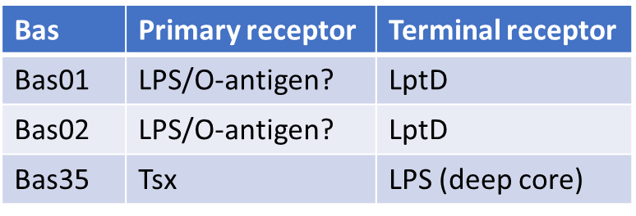
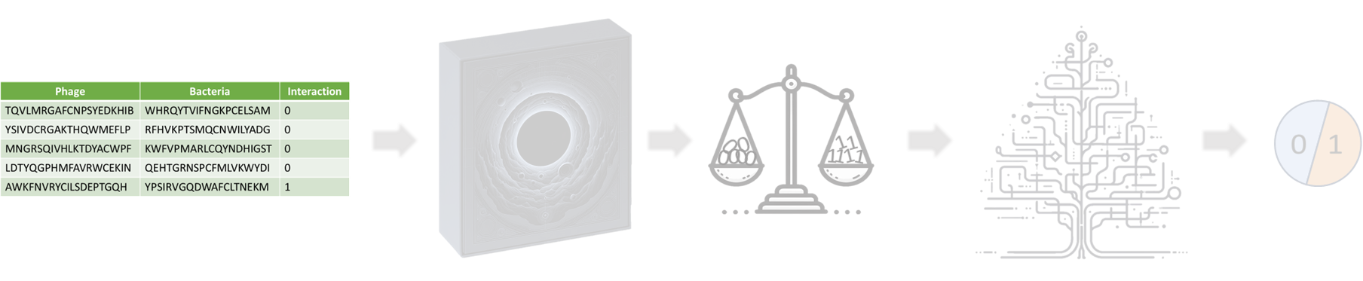
Protein | Sequence | Locus_tag
terminase small subunit | MSKAALKMGE… | Bas01_0001
hypothetical protein | MKGFIKLFI… | Bas01_0002
terminase large subunit | MANLIWEEMT… | Bas01_0003
BASEL proteome
Gene | Sequence
mgtS | MLGNMNVFA…
LptD | MVQIPQNPLI…
frdA | MQTFQADLAI…
Protein receptor
K12 proteome
Tail fiber | Partner receptor | 1
Non tail fiber | Any host protein | 0
Tail fiber | Not-partner receptor | 0
Tail fiber | Any host protein (not partner) | 0
BASEL receptors
Bas | Primary receptor | Terminal receptor
Bas01 | LPS/O-antigen? | LptD
Bas02 | LPS/O-antigen? | LptD
Bas35 | Tsx | LPS (deep core)
Phage | Bacteria | Interaction
TQVLMRGAFCNPSYEDKHIB | WHRQYTVIFNGKPCELSAM | 0
YSIVDCRGAKTHQWMEFLP | RFHVKPTSMQCNWILYADG | 0
MNGRSQIVHLKTDYACWPF | KWFVPMARLCQYNDHIGST | 0
LDTYQGPHMFAVRWCEKIN | QEHTGRNSPCFMLVKWYDI | 0
AWKFNVRYCILSDEPTGQH | YPSIRVGQDWAFCLTNEKM | 1

Slide 13
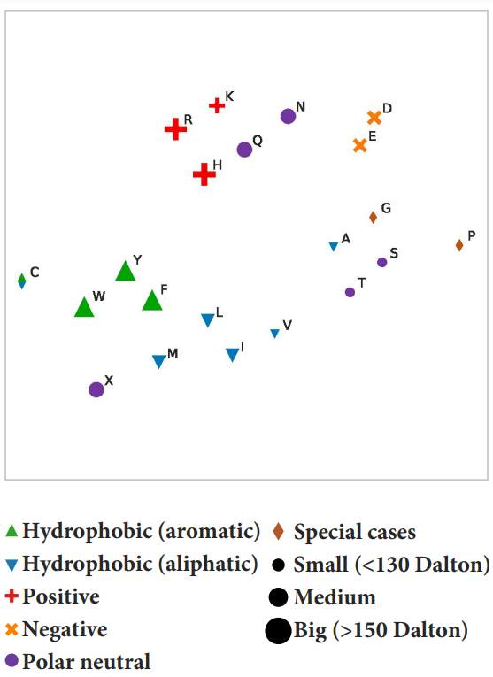
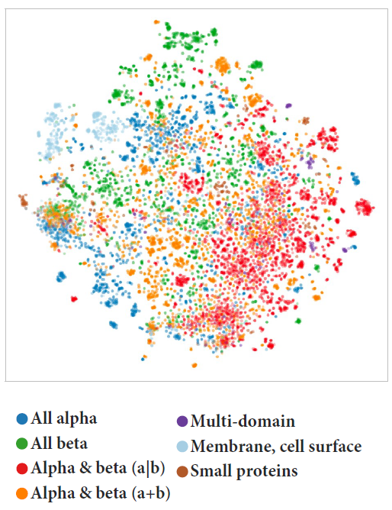
Language models
ProtT5
ProtXLNet
Plots: Ahmed Elnaggar et al. “Prottrans: Toward understanding the language of life through
Selfsupervised learning”. In: IEEE transactions on pattern analysis and machine intelligence
44.10 (2021), pp. 7112–7127.
Notes:
Aminoacidic sequences converted to vectors using language models previously trained on protein data
Protein sequences can be long -> chosen because don’t have input length limitations
T5 is a transformer with encoder (lan -> vector) decoder (vector –> lan2) structure
XLNet isa decoder
T5 produces per residue (fixed len)-> average to fixed len protein
Tested on supervised tasks in both ways and performs good

Slide 14
Random forest
CART
Gini impurity
Reduce Bias
Bagging
Samples size and feature space
Notes:
Expansion of CART -> split samples in subgroups until belong to (almost) same class
Number of features for splitting -> threshold and better purity
Gini of a leaf sum of squared probabilities -> Gini index of tree is the weighted average
Splitting parameters and thresholds introduce bias -> Random forests pool predictions (majority vote in classification).
Further randomization: bagging (out-of-bag)
Small samples size and big feature space.

Slide 15
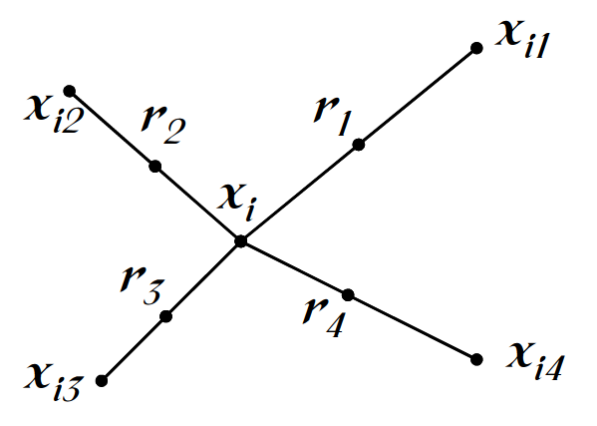
Balancing problem
SMOTE: Synthetic Minority Oversampling Technique
ADASYN: Adaptive Synthetic Sampling
Alberto Fernández et al. “SMOTE for learning from imbalanced data: progress and challenges, marking the 15year anniversary”. In: Journal of artificial intelligence research 61 (2018), pp. 863–905.
Notes:
Many datasets present a binary classification. Sometimes a class is underrepresented -> algorithm can’t train properly on the minority category
A classifier that predicts only majority would have a deceivngly higb accuracy. You need a way to increase the number of samples in the minority class
Smote: instead of reproposing existing observations, introduces synthetic instances. Addition of neighboring points
ADASYN: improved representation of harder to learn -> number of synthetic proportional to majority class neighbours

Slide 16
Nested CV and parameter tuning
Combination 1
Combination 2
Combination 3
Notes:
Scoring a model on a simple train-test split leads to biased estimations -> CV (folds)
Performed parameter tuning using gridsearch with a nested CV.
On each outer partition, an inner CV loop is performed for each parameter combination
The best performing parameter combiantion is used to train a model on the outer fold

Slide 17

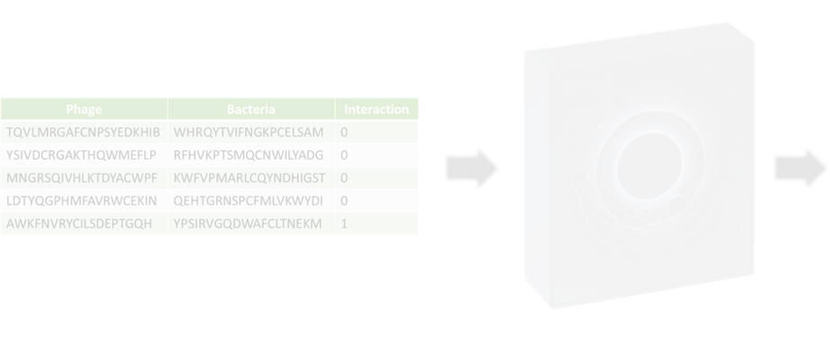
Nested CV and parameter tuning
CV and Grid Search
Notes:
the resampling and the classification must be performed inside the nested crossvalidation.
Generating the synthetic samples before arranging the data
into folds would result in some identical observations between train and test sets, leading
to optimistic performance estimations, as well as not representing the real distribution.

Slide 18
Results and discussion

Slide 19


Represent true population
Other
Other
RBP
RP
Negative >> Positive
Ratio and real-world usage
Notes:
Idea: RBP-RP interaction predictor, given two generic protein sequences
Many more negative than positive combinations, open to interpretation (expected input)
Ratio of negative and positive

Slide 20
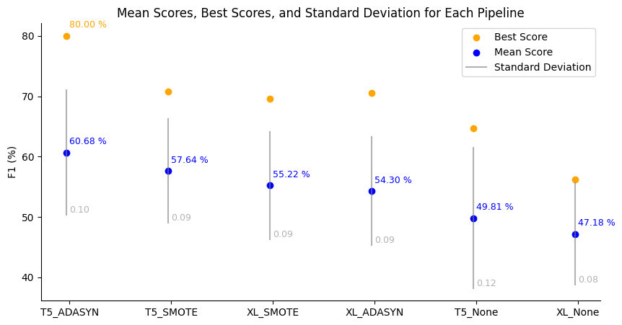
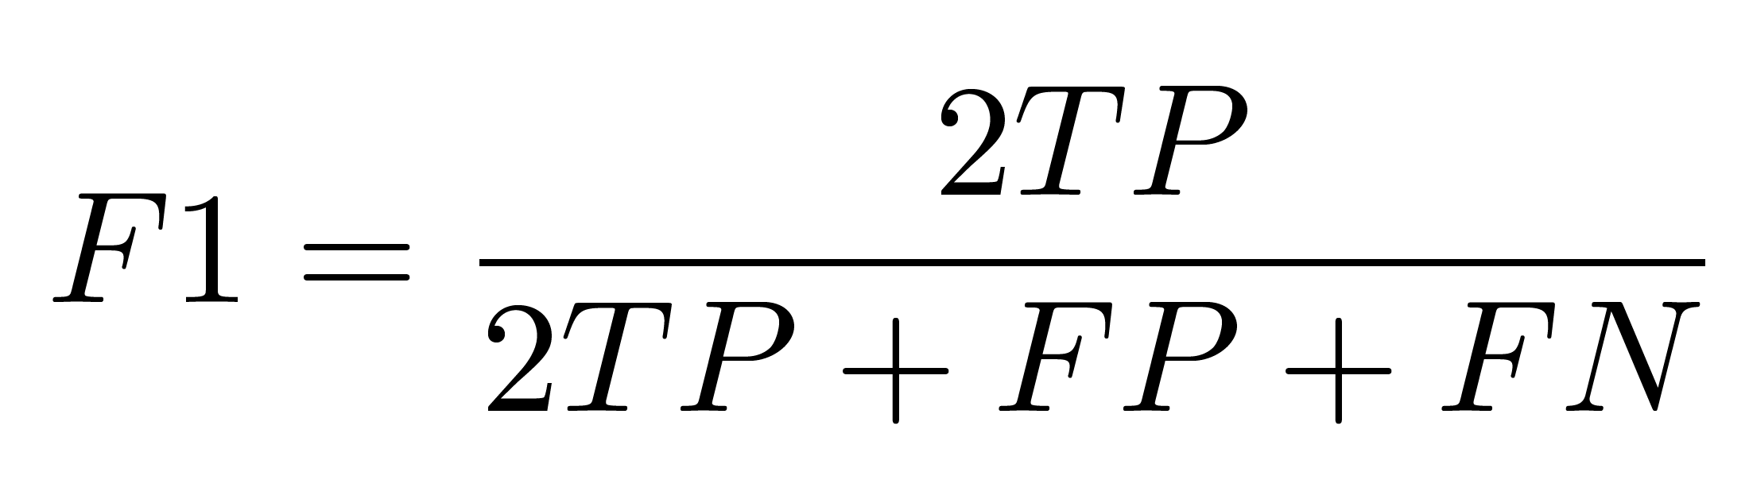
Overall results
Best overall parameters trained on whole dataset:
Mean: 60.37 %
Std: 0.07
Best: 72.34 %
Notes:
Pipelines
F1 is defined as harmonic mean of precision and recall. Undefined with TP=0. So more convenient this expression.
F1 collects both precision and accuracy -> target metric.
Outer folds (different winning combinations of parameters in inner cicle) -> best outer in orange
T5 > XLNet (confirms gonzales et al)
ADASYN vs SMOTE unclear
Best overall was retrained on the whole dataset (not much difference)

Slide 21
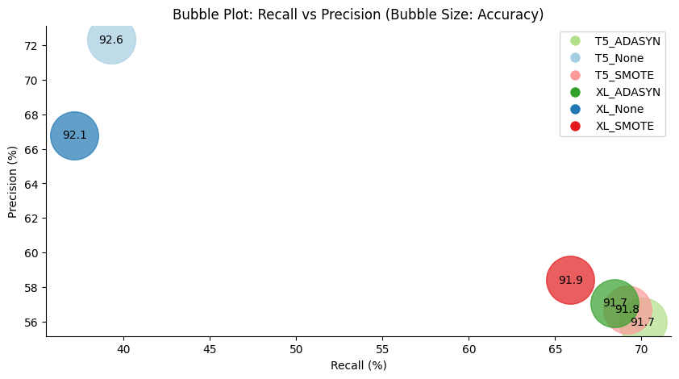
Overall results
Notes:
Resampling technique influenced the learning strategy:
None -> expect few positives -> strict (hihg precision, at the price of a low recall)
Others -> Viceversa
Some distinction between t5 and XLNet
Constantly high accuracy, but not to be trusted, due to dataset imbalanced nature

Slide 22
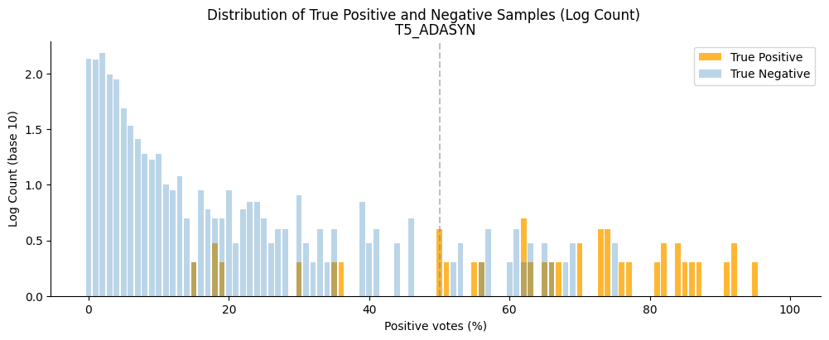
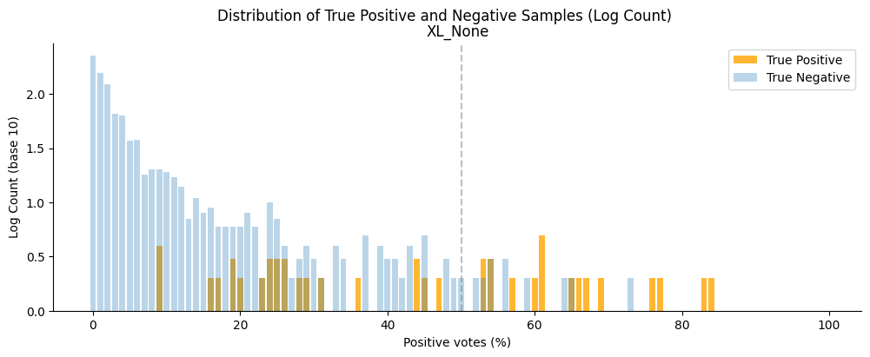
Moving the threshold
Notes:
Neg and pos distributions. Log10 because neg >> pos, to make it visible.
Majority vote aka 50% probability determines positives. Moving the threshold line changes the score metrics.
Show TP etc, Precision, Recall, Accuracy (a lot of blue, always good).
If a model splits the two distributions, it’s easy to determine a proper threshold
Higher threshold usually means higher precision and lower recall.
T5 better separation, None overlaps and skewed left (easier tendency to deem observations not-interacting)

Slide 23
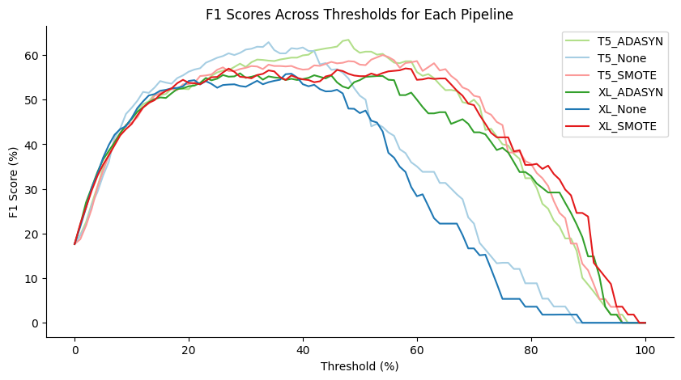
Moving the threshold
Notes:
Obvious diverse behaviour of the pipelines without oversampling.
Most curves top at F1 60%, but the None drop after 50% threshold -> left-skewed distributions (reduce TP reduce F1)
All curves reach 0 around 95% -> no prediction is 100 % confident
ProtT5 contantly better than XLNet
Anticipated peak is essentially the general best. More precisely, 48% and 63.4% Noticeably, T5_None similar result at 34%

Slide 24
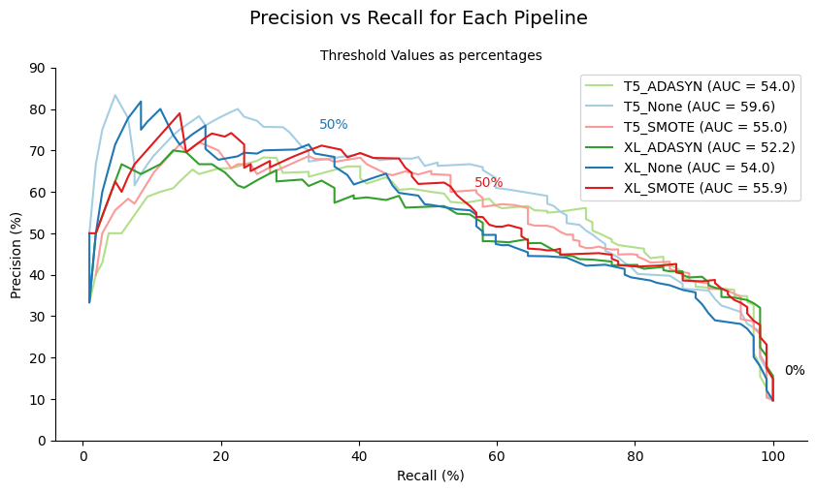
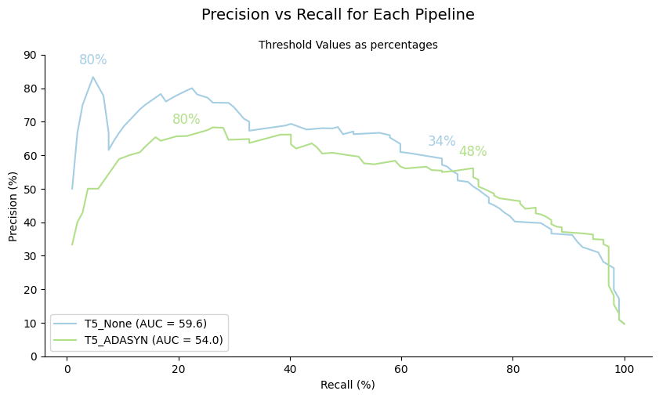
Moving the threshold
T5_None (34 % threshold):
Precision: 59.02 %
Recall: 67.29 %
T5_ADASYN (48 % threshold):
Precision: 56.12 %
Recall: 72.90 %
Notes:
Precision vs recall at various thresholds. Note that same threshold is not at the same X.
Compare the middle split value . The None have lower recall.
Top scorer compared -> values corresponding to top values have similar precision and recall. Maybe a different use could lead to a different preference.
Auc 5 points higher for none, but tricky, because the threshold moves faster to the left -> recall quickly reduces, less stable model.

Slide 25
Comparisons

Slide 26
Similar classifications
Boeckaerts et al.
Hand crafted features
Classifiers
Host species
Multiple class
Gonzales et al.
Aminoacidic sequences
LLM + RF
Host genus
Multiple class
Federico
Aminoacidic sequences
LLM + RF
PPI
Binary
Notes:
Boeckaerts
No language model
Hand crafted features – calculated from DNA and protein sequences
Host species
Multiple class
Gonzales
Large language models
Aminoacidic sequences
Host genus
Multiple class
Federico
Large language models
Aminoacidic sequences
PPI
Binary

Slide 27
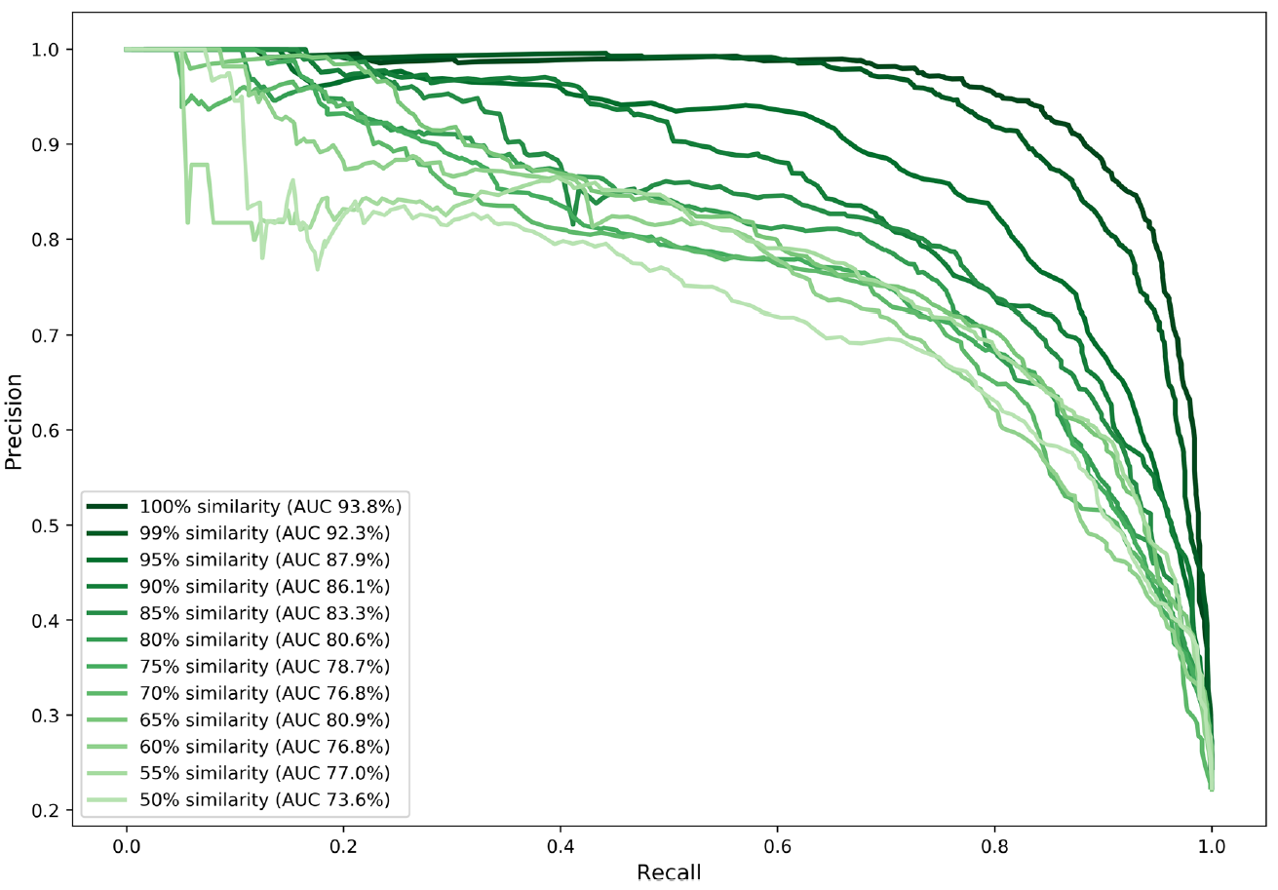
Boeckaerts et al.
Grouped sequences
Random forest
Lower threshold = Lower performance
Z-scale descriptor
GC-content
Notes:
Features: GC content, frequency of each amino acid, molecular weight of protein, many chemichal-physical qualities [total 218]
(nested cv was used) Grouped according to similarity of their sequences -> reduce redundancy across fold
Random forest selected as best classifier
Different set up. Direct confrontation is incorrect, but we can make some considerations
Lower grouping threshold, lower performance -> we could improve results with clustering
Important features:
Z-scale descriptor (amino acids lipophilicity) -> speculate that different measures are required forheterogeneous hosts
GC content -> not obtained from protein sequence. Used for evolutionary distance. However, genome dissimilarity might harm a successful infection –> label as 0 (possible bias) -> might embed DNA seq instead

Slide 28
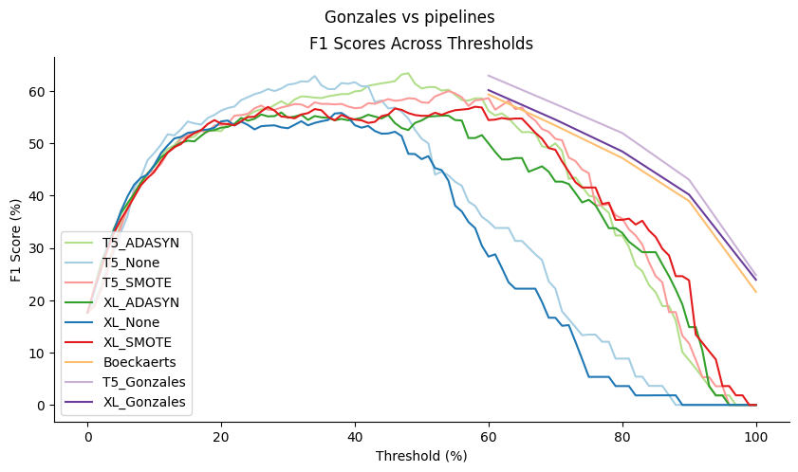
Gonzales et al.
96% entries for 25% of the hosts
Confidence
Embedded chemistry
Post-translational modifications
Environment
Notes:
96% of the entries are associated with only 25% of the host genra -> 75% labeled ‘others’
Confidence as difference of probability in the first 2, if lower than threshold, others -> binary is 1 – 0, else misclassified
I had to change the one in the thesis, I realized it was wrong
Gonzales (+ Boeack) > than mine
Also in Gonzales, ProtT5 > ProtXLNet
Genus (quite good) vs PPI (less satisfactory, more complex)
Embedded chemistry -> embeddings might encode physical-chemical features (polarity, electrical charge, surface residues), which might be enough to distinguish between target genuses. They probably have similar outer structures that give access to molecules with similar characteristics. PPI requires detailed information about size and complementarity of shapes
Post-translational modifications (encoded in the gene or elsewhere in the genome)
Environment influences conformation and behavior (pH and temperature, competing reactions)

Slide 29
Space for improvement
RBP – RP
Multiple hosts
Interaction labeling
Dataset proportions
Fine-tuning
RF input shape
Residue encodings
Notes:
RBP – RP
Multiple hosts
Interaction labeling
Dataset proportions
Fine-tune LLM on coupled sequences
Reshape input for RF (instead of side-by-side, sum or multiply element wise)
Residue encoding (self-attention and cnn might be promising algorithm for this shape of data)

Slide 30
Thank you

Slide 31
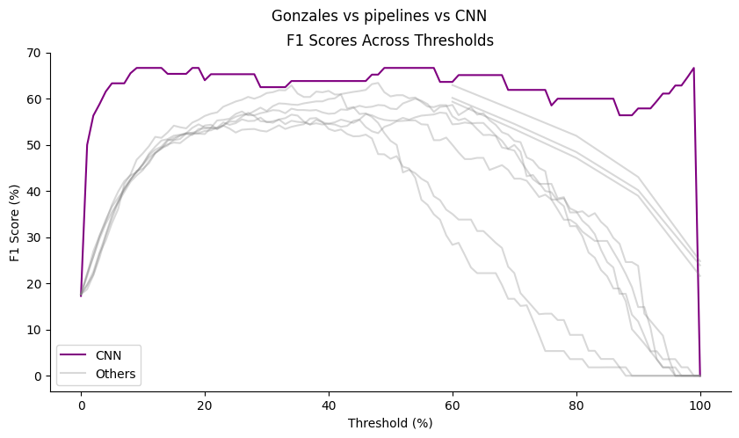
Neural Network
Self attention
CNN
Test size: 20 %
Epochs: 70 (early stopping from 800)
Notes:
The best threshold for CNN is 9 The best F1 score for CNN is 66.66666666666666
The best threshold for T5_ADASYN is 48 The best F1 score for T5_ADASYN is 63.41463414634146
The best threshold for T5_None is 34 The best F1 score for T5_None is 62.882096069869
The best threshold for T5_SMOTE is 54 The best F1 score for T5_SMOTE is 60.0
The best threshold for XL_ADASYN is 29 The best F1 score for XL_ADASYN is 55.90062111801242
The best threshold for XL_None is 38 The best F1 score for XL_None is 55.81395348837209
The best threshold for XL_SMOTE is 58 The best F1 score for XL_SMOTE is 56.99999999999999
The best threshold for Boeckaerts is 6 The best F1 score for Boeckaerts is 59.35
The best threshold for T5_Gonzales is 6 The best F1 score for T5_Gonzales is 62.949999999999996
The best threshold for XL_Gonzales is 6 The best F1 score for XL_Gonzales is 60.18

Slide 32
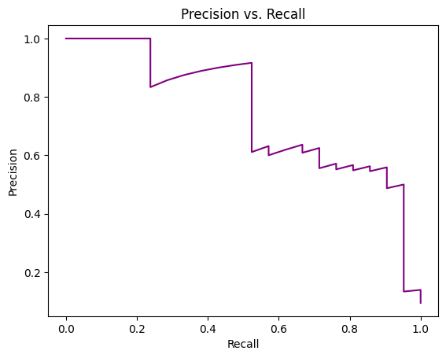
Neural Network
Self attention
CNN
AUC = 74.5 %
Notes:
You can choose if you prefer precision or recall, moving the threshold

Slide 33
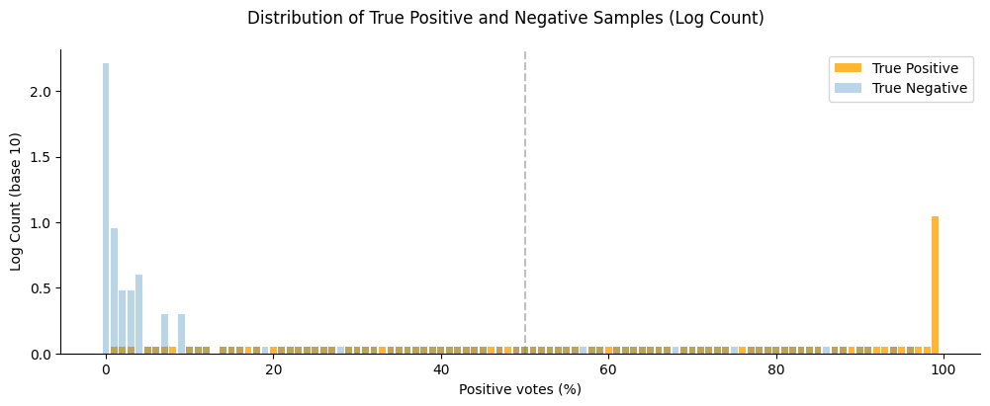
NeuralNetwork
Notes:
The low ones are counts of 1, I displayed them manually because with the log they would disappear

